Slide 1
Subsystems and Incremental Testing
Subsystems
Testing and Incremental Testing
Identify Subsystems and Incremental Testing Opportunities

Slide 2
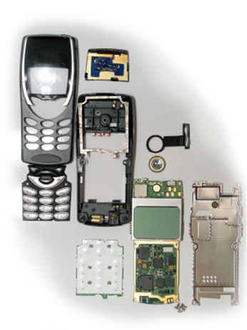
Subsystems
A major part of a system which itself has the characteristics of a system, usually consisting of several components.
©iStockphoto.com
Most devices that seem simple actually have many subsystems.

Slide 3
Testing and Incremental Testing
Testing: A procedure in which the performance of a product is measured under various conditions.
In the next unit, you will plan and execute most of the testing.
Incremental Testing: Testing components or subsystems in isolation that will be integrated into a larger system.
You will troubleshoot problems in isolation that affect the overall system.
Notes:
Explain to students that most of their test planning and testing will occur in the unit after they build the prototype, but that some planning and testing during the build phase is important to isolate problems sooner rather than later.
Incremental testing may be more or less formal than their larger tests, but troubleshooting some basic issues early can improve the overall design or may even keep it from failing based on one component.
It is also important to point out that many engineers work hard to solve just one subsystem, component, or part of a given or existing system.

Slide 4
Identify Subsystems and Incremental Testing Opportunities
What are the subsystems?
What can be tested incrementally?

Slide 5
Identify Subsystems and Incremental Testing Opportunities
What are the subsystems?
What can be tested incrementally?

Slide 6
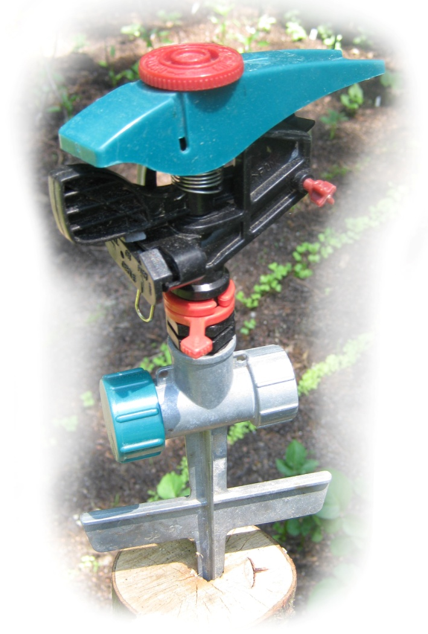
Identify Subsystems and Incremental Testing Opportunities
What are the subsystems?
What can be tested incrementally?

Slide 7
Identify Subsystems and Incremental Testing Opportunities
What are the subsystems?
What can be tested incrementally?

Slide 8
Identify Subsystems and Incremental Testing Opportunities
What are the subsystems?
What can be tested incrementally?

Slide 9
Identify Subsystems and Incremental Testing Opportunities
What are the subsystems?
What can be tested incrementally?

Slide 10
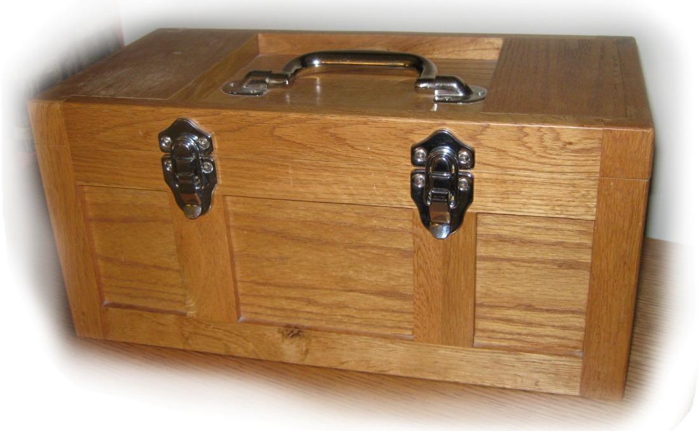
Identify Subsystems and Incremental Testing Opportunities
What are the subsystems?
What can be tested incrementally?

Slide 11
Identify Subsystems and Incremental Testing Opportunities
What are the subsystems?
What can be tested incrementally?

Slide 12
Subsystems and Incremental Testing
Subsystems
Testing and Incremental Testing
Identify Subsystems and Incremental Testing Opportunities

Slide 13
Image Resources
iStockphoto. Retrieved from http://www.istockphoto.com/index.php
Microsoft, Inc. (n.d.). Clip art. Retrieved from http://office.microsoft.com/en-us/clipart/default.aspx

