Slide 1
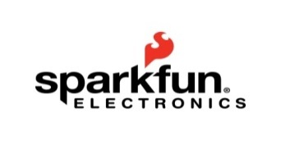
The Center for the Advancement of Science in Space
Manager of the International Space Station U.S. National Laboratory
National Design Challenge Pilot Program

Slide 2
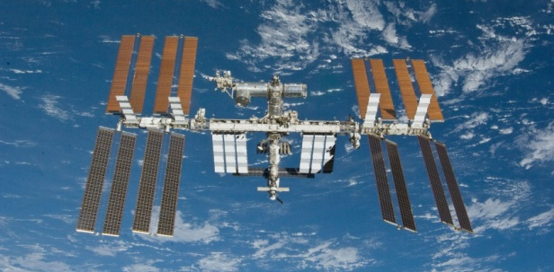
Congratulations and Welcome!
The NDC program will take place in three Denver area schools:
Bell Middle School (Golden) – Lead Educator Shanna Atzmiller
Centaurus High School (Lafayette) – Lead Educator Brian Thomas
Chatfield Senior High School (Littleton)– Lead Educator Joel Bertelsen

Slide 3
CASIS National design challenge Pilot program
The CASIS National Design Challenge (NDC) will engage educators in inquiry based scientific and engineering practices by designing and building an experiment to be flown on the ISS U.S. National Lab
The NDC Pilot Program will serve as a “proof of concept” that could be duplicated in other areas of the country before implementing on a national level

Slide 4
CASIS National Design challenge Partners
NanoRacks will provide the technical payload integration services and on-orbit hardware and logistical requirements
Texas A&M MISL will provide the selected schools with the NanoLab hardware, technical support and professional development for the teachers
Wings Over the Rockies will host meetings, professional development training and other related events
Spark Fun Electronics will provide input for teachers on hardware components, sensors, etc. to support experimental designs; located in Boulder

Slide 5
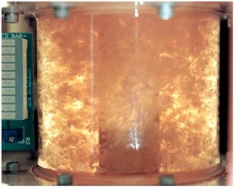
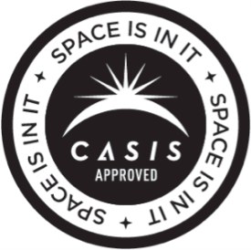
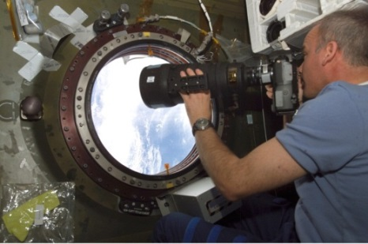
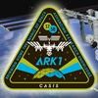
International Space Station: Background
Took 10 years and over 30 missions to assemble; the result of collaboration among 5 space agencies representing 15 countries
CASIS is the nonprofit manager of the International Space Station’s U.S. National Laboratory, supporting non-exploration R&D across a broad range of basic and applied sciences
Cancer cells
Images courtesy of NASA
Notes:
The space station is about the size of a football field: A 460-ton, permanently crewed platform orbiting 240 miles above Earth.
ARK1 mission patch
Jeff Williams, Expedition 13 Science Officer, at the U.S. Laboratory Science Window on station
Bioreactor-cultivated, 5-day human colon cancer cells aboard the space shuttle (STS-70).
Cells grew to 30X the volume of ground controls
Result reproduced on STS-85: mature structures that more closely match those found in human tumors

Slide 6
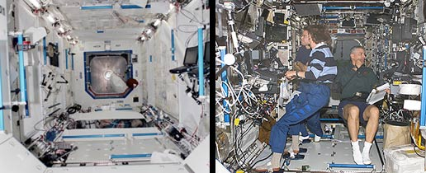
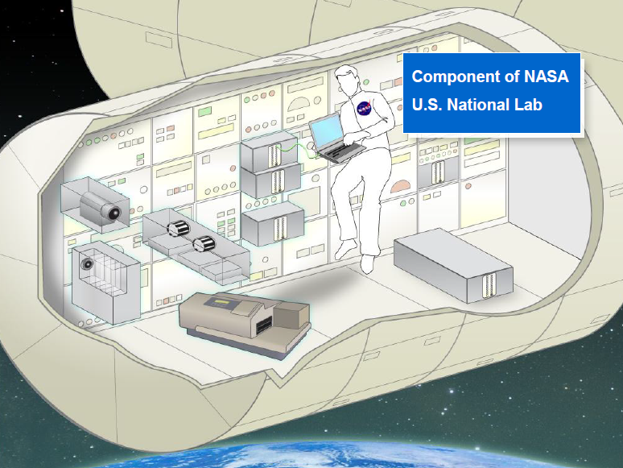
International Space Station: Background
The entire international laboratory is the size of a U.S. football field, with the interior volume of one and a half Boeing 747 jetliners
Inside Destiny: just after installation and after outfitted for research
Artist’s rendition of a space station research area
(courtesy of NanoRacks)
Images courtesy of NASA

Slide 7
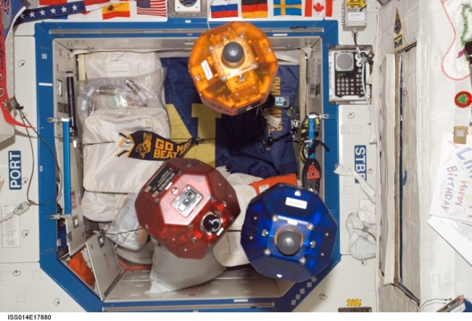
Maximizing value of the ISS
CASIS seeks to maximize the value of the station to the nation
Fully utilize the Station for basic and applied scientific research
Inform the general public through outreach on the opportunities and benefits realized through station
Synchronized Position Hold, Engage, Reorient, Experimental Satellites
Support education efforts that establish the ISS U.S. National Laboratory as a leading laboratory and environment for science, technology, engineering and mathematics (STEM) education.

Slide 8
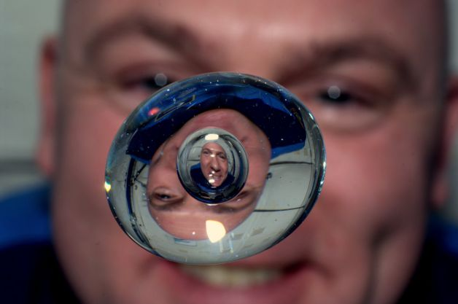
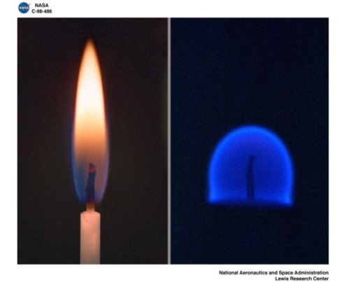
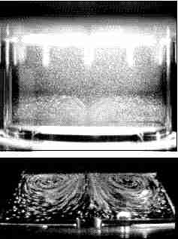
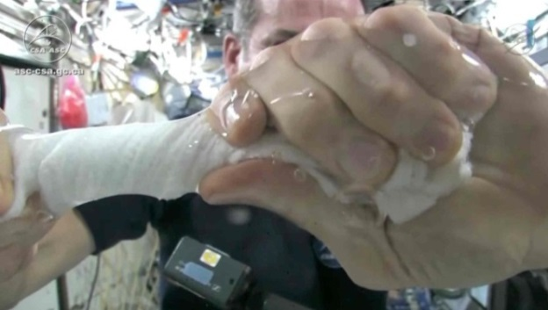
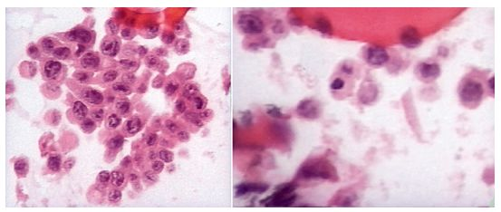
The research environment: Microgravity Why send research into space?
Microgravity alters many observable phenomena
Flame structure in space
Thermocapillary flows
Earth
Andre Kuipers, NASA
Earth
Space
Colon carcinoma cell aggregation
Space
Chris Hadfield, CSA
Earth
Space
Images courtesy of NASA
Notes:
In this image provided by NASA astronaut Andre Kuipers watches a bubble in a drop of water as he enjoys the last days of weightlessness. The photo was taken June 24, 2012.

Slide 9
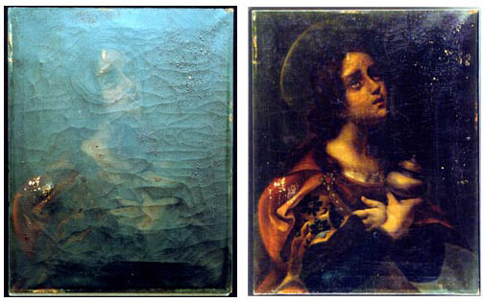
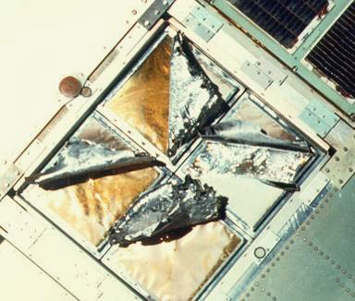
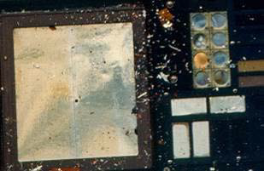
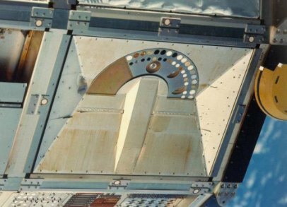
The research environment: extreme conditions
Exposure to
extreme heat and cold cycling
ultra-vacuum
atomic oxygen
high energy radiation
debris impact
AO satellite-preservation technique used for art restoration
Structural degradation
Radiation-induced darkening
Debris damage
Images courtesy of NASA
Notes:
Many specific conditions are accessible on the exterior of the space station:
Extreme temperature cycling (external temperatures range from -200°C to 200°C [-328°F to 392°F]).
Atomic oxygen, a damaging form of the oxygen molecule that causes erosion of polymers
Solar radiation (without the filter of Earth’s atmosphere), which also damages polymers, coatings, and fabrics
Vacuum conditions, which alter the physical properties of many materials
Meteoroids and orbiting man-made debris that impact and damage materials
The combined effects of these conditions can be investigated only in space. Testing of materials exposed simultaneously to these extreme conditions have provided data to enable the manufacturing of long-life reliable components used on Earth as well as in the world’s most sophisticated satellite components
Example of a success story on Earth that’s a spin-off of space technology
Atomic oxygen techniques developed from satellite preservation research on station have been applied to art restoration
This is a Raphael original, “Madonna of the Chair,” that was damaged in a fire.
The left photo was taken after the Cleveland Museum of Art's staff attempted to clean and restore it using acetone and methylene chloride.
The right photo is after cleaning by the atomic oxygen technique.
Other images show results from “exposure” research that was part of the NASA MISSE series (Materials International Space Station Experiment)

Slide 10
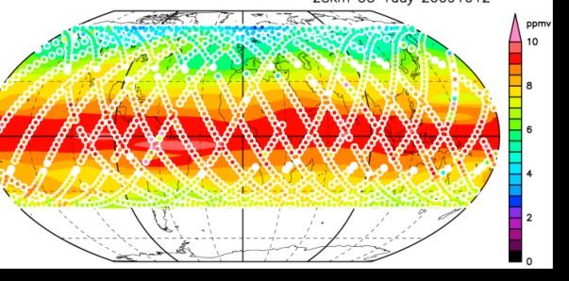
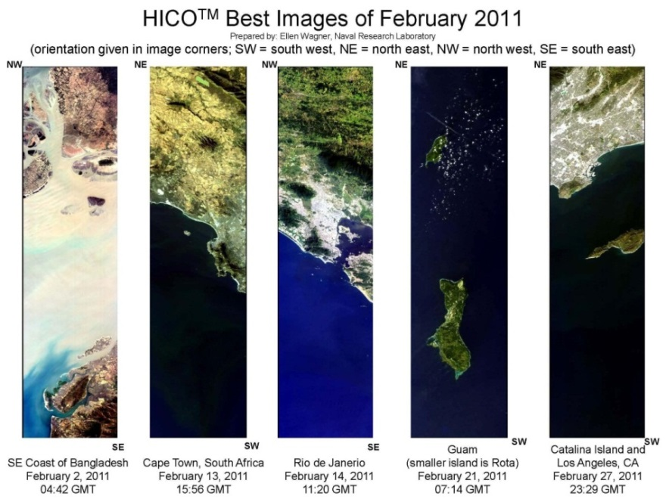
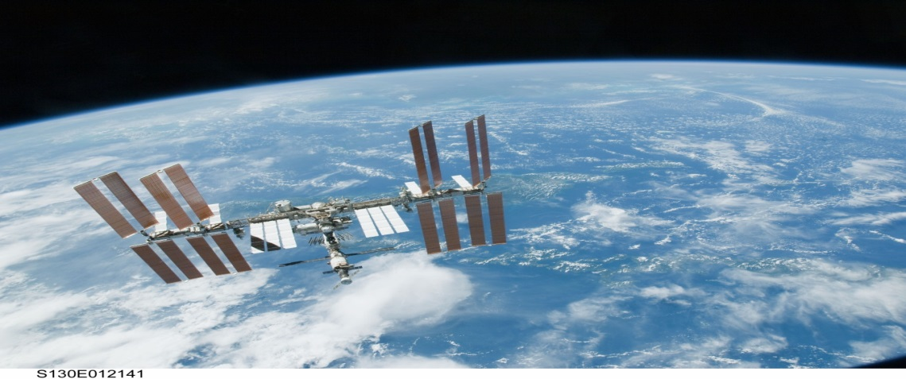
The research environment: Low earth orbit
Orbital path over 90% of Earth’s population
Altitude ~240 mi (400 km)
Unique microgravity environment
90 minute orbit traveling at 17,500 miles/hr.
Globally mapped ozone distributions
Spot the Station Website: http://spotthestation.nasa.gov
Image courtesy of NASA
Notes:
Its location in low Earth orbit affords the National Lab a unique vantage point
Benefits for Earth observation data collection: average altitude of 400 km, orbital path covering 90% of Earth’s population
Improved spatial resolution (<6 m) for Earth viewing
Variable lighting conditions for Earth viewing (versus orbiting satellites)
Capability to measure or detect X-ray sources, cosmic rays, solar spectral irradiance and neutron flux in space (e.g., the full cosmic ray spectrum can be studied only from space)
Exploiting this platform for Earth observation and remote sensing of space allows a broad range of studies with equally broad implications for basic and applied science across many fields. For example:
The ability to measure solar energy irradiance into Earth’s atmosphere reveals the effects of this irradiance on atmospheric modeling, atmospheric chemistry and climatology
The capability to measure or detect X-ray sources, cosmic rays, solar spectral irradiance and neutron flux in space allows studies not possible on Earth
Images:
MAXI is a highly sensitive X-ray slit camera externally-mounted to the International Space Station for monitoring more than 1,000 X-ray sources in space, including black holes and neutron stars. In 2010, MAXI found two new X-ray sources from its sky scans
SMILES made atmospheric observations in 2009/2010 with the aid of a 4 K mechanical cooler and superconducting mixers for submillimeter limb‐emission sounding in the frequency bands of 624.32–626.32 GHz and 649.12–650.32 GHz
On the basis of the observed spectra, the data processing has been retrieving vertical profiles for the atmospheric minor constituents in the middle atmosphere, such as O3 with isotopes, HCl, ClO, HO2, BrO, and HNO3. Globally mapped ozone distributions at 28 km on 12 October 2009. Original observation points are plotted by white circles with observed ozone mixing ratios.
SUCCESS STORIES:
The ISS houses the first space-based method of tracking global maritime traffic, capable of autonomously monitoring ships’ speed, position, course, cargo and voyage information in open waters (versus Earth-based systems, which can only monitor coastal waters).
Earth Observation capabilities on station have been used to aid in disaster recovery efforts after, for example, a volcanic eruption or the 2011 Japanese tsunami. They have also been used to monitor global environmental hazard risks, such as the melting of glaciers that caused a Russian avalanche in 2002.
In 2010, two new X-ray sources were identified in space using two facilities on station:
Monitor of All-sky X-ray Image (MAXI), which is
comprised of a couple highly sensitive
X-ray detectors, the Gas Slit Camera and
the Solid-state Slit Camera
Swift, a first-of-its-kind multi-wavelength
observatory dedicated to the study of
gamma-ray bursts (GRB) and other transients

Slide 11
the ISS National Lab by sector
InfoTech
Optical Fibers
Semiconductors
Crystalline Materials
Amorphous Materials
Metallic glasses
Energy/Chemical
Microgravity-enabled materials and Chemistry
Clean Energy
Technology Maturation
Aerospace
Technology Maturation
Technology Development
Test Bed Services
Advanced Manufacturing and Materials
Remote Sensing and E/O
Life Science
Stem Cells, Regenerative Medicine
Cell Biology, Genomics
Protein Crystallization
Aging, Osteoporosis, Muscle Wasting
Immune Response, Virulence
Cleantech
Remote Sensing
Biofuels
Combustion
Materials
Materials
Microgravity enabled materials
Combustion
Remote Sensing

Slide 12
CASIS Projects on station
Payloads recently delivered to ISS
Procter & Gamble: Colloid research
UColorado-Boulder: Antibiotic resistance
NanoRacks: CubeSat Deployer
Education Projects:
T2 Education: Story Time From Space
Stanford: Ants in Space
NIH: T-Cell activation in aging
UFlorida: Plant growth and development
Merck, iXpressGenes, and others: Protein crystal growth
Notes:
Increment 37/38

Slide 13
Planned for flight this year
Projects planned for delivery in the coming year:
Anti-cancer drug evaluation (VA)
Muscle atrophy in mice (Novartis) and immunology (DoD)
Gumstix™ fault-tolerant computers (Advanced Materials LLC)
Carbon nanotube photovoltaic cells (Georgia Tech)
Materials science for sporting equipment (Cobra Puma Golf)
Protein crystal growth (including the Broad Institute)
Wound healing/regeneration in planarians (Kentucky Space)
And others…

Slide 14
NDC Houston Experiments
The Effects of Different Wavelengths of Light on Algae Oxygen Production in Microgravity, 4th Grade, Duchesne Academy
Yeast Growth in Space, 5th Grade, Awty International School
Use of Boron-Enhanced High-Density Polyethylene for Radiation Shielding, 8th Grade, Awty International School
The Effects of Microgravity and Light Wavelength on Plant Growth in an ArduLab, 8th Grade, Duchesne Academy
The Behavior of Slime Molds (Physarum) in Microgravity, High School, Cristo Rey Jesuit School
Self-assembly of Mesoscopic Lipid Mimics, High School, Cristo Rey Jesuit School

Slide 15
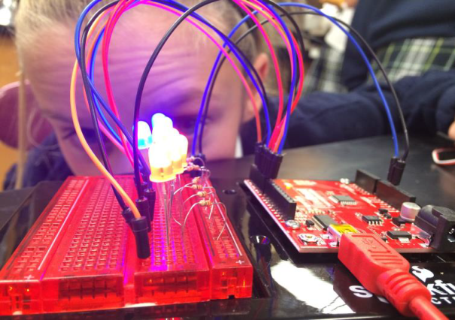
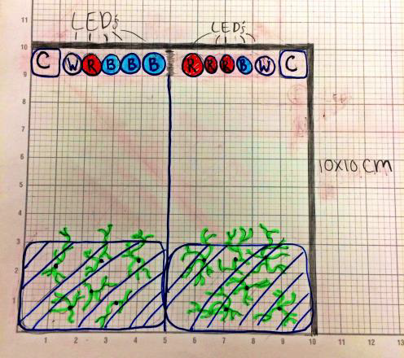
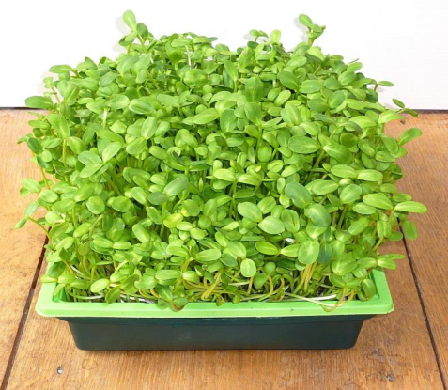
NDC Houston Experiments

Slide 16
Denver Experiments
Does Vermicomposting in a Closed System have the Same Efficiency in Microgravity as it Does on Earth?, Bell Middle School
The Effects of Simulated Gravity on Bacterial Lag Phase in a Micro-Gravitational Environment, Centaurus High School
The Green Machine – Making Hydrogen in Space, Chatfield Senior High School

Slide 17
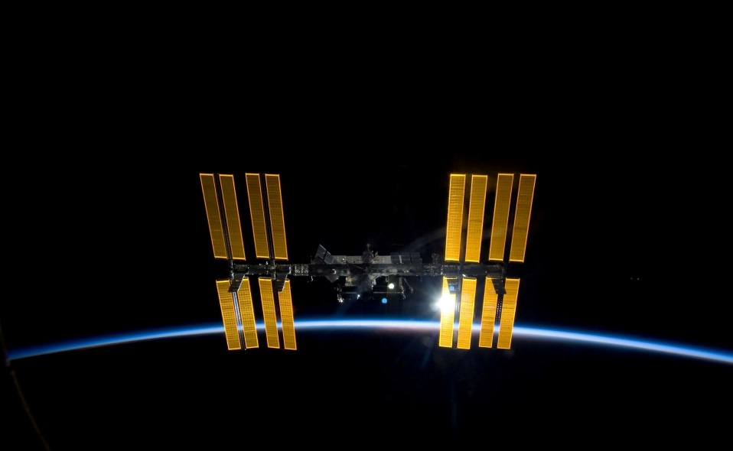
Where do we start?
School will:
Designate POC for your school
Sign grant agreement with CASIS
Attend Professional Development Workshops provided by CASIS and Texas A&M to be held July 21st – 25th at Wings Over the Rockies
Design experiment to fit inside a 1.5U NanoLab; purchase materials
CASIS will purchase NanoLabs (flight and ground based) and 8 months of technical support from Texas A&M MISL
ASK LOTS OF QUESTIONS!
Notes:
Value of grant agreement is 10K; CASIS is paying for NanoLabs and technical support with $3800; schools will have remaining $6200.

Slide 18
Introduction to NDC Mentor Alli Westover
Biomedical Engineer from Texas A&M University
Works at NASA JSC
NASA Extreme Science Mentor for HUNCH
Crew training for science experiments on MIR
Advanced Projects Lead for future medical hardware
Preflight and postflight evaluation of crew health
Former Engineering Design Teacher at Clear Springs High School
NASA HUNCH: plant growth chamber/other hardware for ISS, flying on Orbital Rocket 3 to ISS.
Zero Gravity Flight to test experiment in microgravity
Notes:
Biomedical Engineer from Texas A&M University
Worked at NASA JSC
Crew training for Science Experiments on the Russian MIR Space Station
Advanced Projects Lead for future medical hardware to use on long duration missions
Pre-flight and Post-flight evaluation of the crew’s medical health
Engineering Design Teacher at Clear Springs High School
Worked with NASA HUNCH to produce plant growth chamber and other hardware for the crew to test on the International Space Station.
Students used Zero Gravity Flight to test Experiment in Microgravity environment.

Slide 19
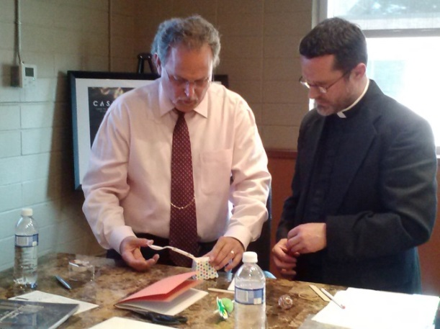
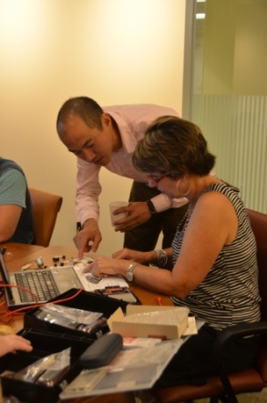
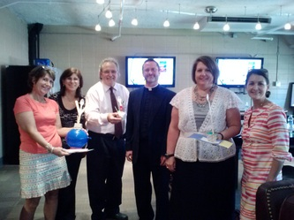
The Key: Professional Development
Alli Westover is the main POC for the educators
Alli will provide professional development and mentoring for educators in microgravity research, experimental design, engineering design and the flight integration process
July 21-25 - week-long training at WOR with Alli and the Texas A&M MISL Team on the NESI microcontroller board and engineering design
Texas A&M staff and local mentors are also available for technical support

Slide 20
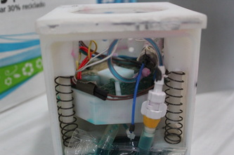
The Nanolab
I.5U cubelab form container
Uses the NESI board microcontroller
Programmable micro-controller, allowing automation, control, and data collection
Notes:
Platform includes a simple programmable micro-controller, allowing automation, control, and data collection of the experiment (lessening the amount of crew time)
Easy to integrate and control hundreds of different analog & digital sensors, stepper motors, cameras, lights, etc. to control and collect data from the experiment on the ISS.

Slide 21
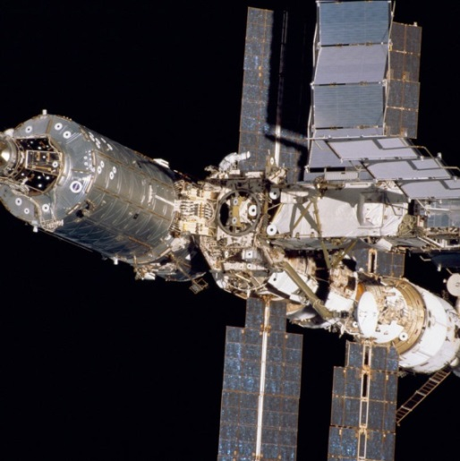
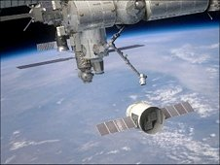
How will my Experiment get into Space?
CASIS is partnering with Texas A&M (developer of the NESI board) and NanoRacks (payload integrator) to send experiments to the ISS National Lab
NanoLabs will be stowed inside the ISS National Lab in a specially designed rack to hold experiments
NanoRacks, in concert with CASIS, will provide technical payload integration services as well as assist in coordinating the launch and on-orbit logistical requirements

Slide 22
National Design challenge Pilot Program Timeline
Summer/Fall 2014
Fall 2014/Winter 2015
Spring 2015
Professional development workshops for teachers to design experiments and implementation plan
Complete experiments; payload integration activities with NanoRacks begin
Fly experiments to the National Lab

Slide 23
National Design challenge Program Timeline
May 8-9, 2014 – Kick-off meeting at Wings Over the Rockies and professional development workshops
July 21-25, 2014 – five days of professional development workshops with Texas A&M and Alli Westover
Summer 2014 – Teachers design their experiments and plan implementation within their schools; MENTORS MAY BE NEEDED
Fall 2014/Winter 2015 – Implement ground and flight-based experiments; payload integration of flight-based experiments begins; MENTORS NEEDED
October 2014 – ISF/Tox forms due to NanoRacks
December 2014 – Safety/Test Experiment Packages due to Nano Racks
December 2014 – NASA Safety Review Board for Experiments
Spring 2015 – Experiments are launched to the ISS
Spring 2015 – Data downloaded and analyzed (up to 30 days)
Summer 2015 – Final project deliverables due for teachers

Slide 24
community Mentor responsibilities
Mentors will be partnered with each selected school based on their project topic and needs; schools can also find their own mentors in the local community
Mentors will assist the teacher(s) and students with a variety of disciplines, including but not limited to, the sciences, computer programming, engineering design and fabrication of space - based flight hardware
Mentors will assist with the iterative design process of the ground and space-based experiment
Mentors will attend teacher workshops (optional)

Slide 25
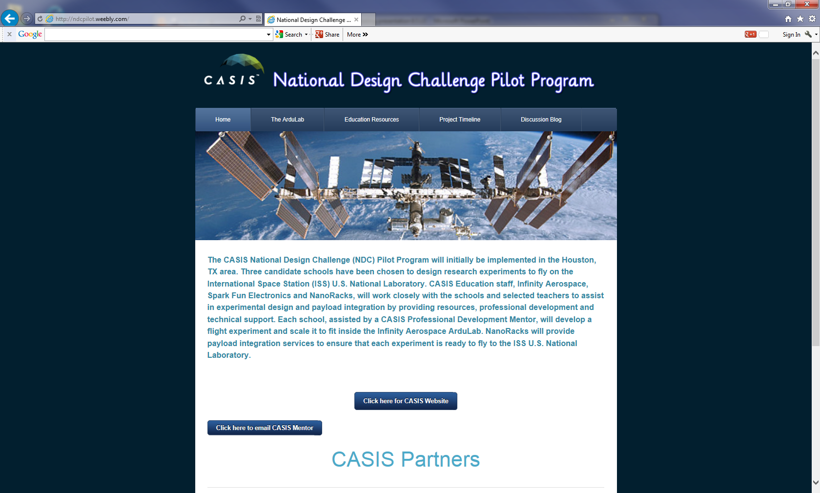
NDC Pilot Program website
Website: http://ndcpilot.weebly.com

Slide 26
CASIS responsibilities
Provide a grant to three schools in the amount of $10,000 each (CASIS will pay for hardware and technical support directly to Texas A&M from grant funds)
Coordinate with NASA for flight and on orbit access to the ISS
Provide a Professional Development Mentor to work with selected schools to provide professional development workshops and project guidance
Provide technical payload development and integration services via NanoRacks, LLC
Define project deadlines

Slide 27
School responsibilities
Use grant money to purchase additional technical support (if needed), fabrication supplies for the NanoLab, teacher stipend(s) and travel costs
Design a flight-based experiment to fit inside a NanoLab to be flown on the ISS; design an identical ground-based experiment to compare to the flight-based experiment
Require that the teacher(s) on the team attend professional development workshops for the program
Require teacher(s) to attend weekly status meetings with the CASIS Professional Development Mentor and with Texas A&M
Required status reports, blog submissions, documentation to the NDC Denver website
Require teacher(s) to submit all the necessary documentation, final report and flight hardware within the project established deadlines
Notes:
Talk to the issue of having arduino.

Slide 28
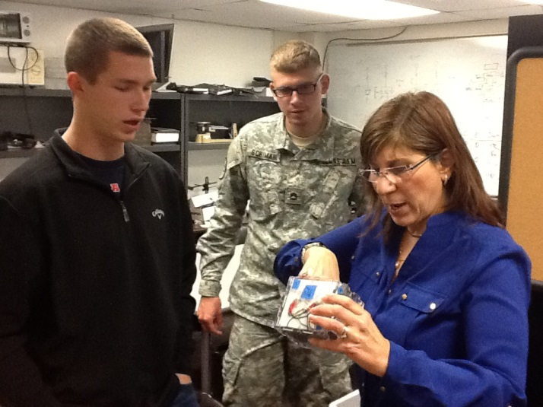
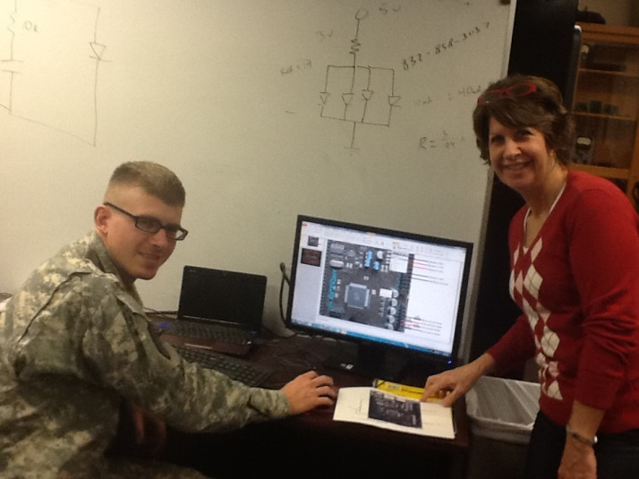
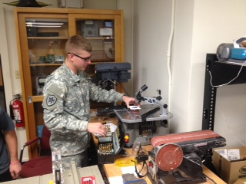
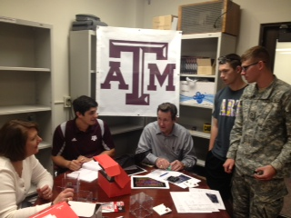
Mentors assisting with Projects

Slide 29
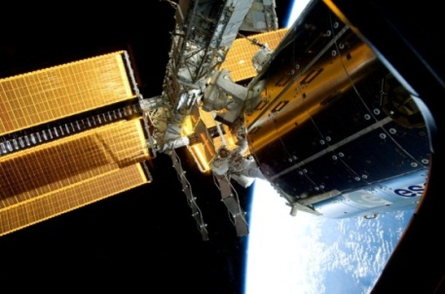
Payload integration
NanoRacks will serve as the “Implementation Partner” for the Pilot Program experiments
This covers:
NASA Hardware & Software Integration Requirements
NASA Payload Safety Requirements
Verification Testing & Analysis
Flight Readiness Preparation
Payload Delivery for Launch

Slide 30
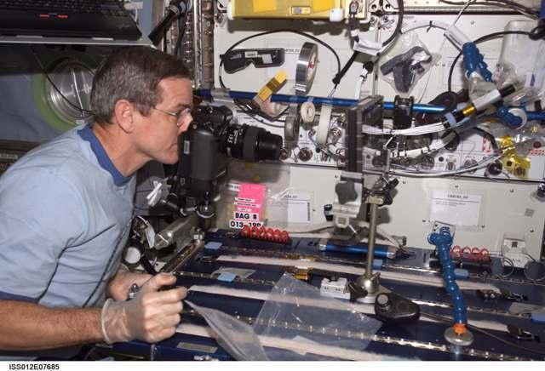
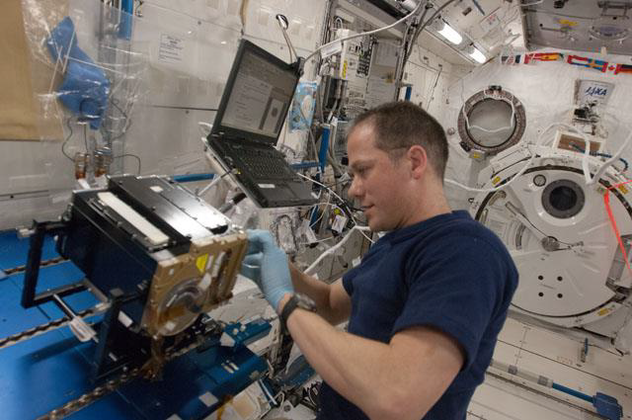
Payload safety
The NASA Payload Safety Review Panel is responsible for ensuring the safety of the crew and the ISS itself are protected
All ISS payloads must demonstrate through analysis, inspection, or testing that any hazards to the safety of the crew or the vehicle itself are removed or controlled

Slide 31
Times and Type of Forms to Expect
L-6 Months
Investigation Summary Form
Hardware Design Details Package
Working description of experiment
Drawings, materials used, components, wiring diagrams, etc.
Required Shipping, Launch, & On-Orbit Operations
How soon after launch do you need activation?
Power usage time
Orientation during launch?
How late can experiment be turned over to us?
Temperature constraints
Data collection frequency

Slide 32
Times and Type of Forms to Expect
L -4 months
Science Sample Details & Material Safety Data Sheets (MSDS)
Chemicals, seeds, cells, etc.
Chemicals/Reagents components, maximum concentration and volumes
pH
Salts
Buffers
MSDS flammability or toxicity levels >3 not allowed.

Slide 33
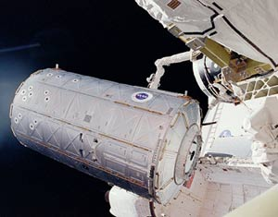
Flight preparation
NASA’s team accepts delivery of payloads directly from NanoRacks
NanoRacks can also load time-sensitive experiments on the launch vehicle as close as 2-3 weeks before launch
This work involves sample prep and packing for stowage on the launch vehicle
Testing of non-NanoRacks hardware
Destiny module

Slide 34
Payload Handover
Nominal handover time is L ~10 weeks
Biological or temperature controlled payloads L -72h (plus time for set-up)
Very special requests granted to L -28h (plus time for set-up)
Needs to be very clear in initial paperwork!
Why so long before launch?
Close out inspections
If errors found, may give time to correct.

Slide 35
PosItive feedback from Parents and administrators
“Thank you Mrs. Knizner for planting a seed of science in Ansley. She had the entire family outside watching for the ISS to cross the sky. We were all thrilled! We are excited to see the sparkle in her eyes as she informs us of the CASIS project and any other science project or research for science in the news.” (parents of Duchesne Academy student)
“I had one parent say that their daughter had never been interested in space, now follows the Space Station, and is excited about what you all are doing…she wants to be an astronaut.” Tony Houle, Middle School Head, Duchesne Academy’
“We believe that this program will give Duchesne students, and when adopted in other schools, a unique learning experience in science and inspire students to pursue science and engineering careers,” Patricia Swenson, head Lower School Duchesne Academy student.

Slide 36
PosItive feedback from Teachers
“The CASIS NDC pilot program has been enlightening and inspiring to me and my students. Our class culture has changed from the teacher being the main source of information to the girls taking ownership and initiative in this project. Our class is using life skills such as coordinating, cooperating and collaborating with others, persevering through errors and mistakes to create new solutions. Our experiment on algae is extremely meaningful to all of us; it is our project and we are proud of it.” Teacher Susan Knizner
“This has been the most challenging and worthwhile project I have ever been involved in. My students are not just learning science they are doing and living science. They are so excited that an experiment that they have designed will fly on the ISS.” Teacher Kathy Duquesnay

Slide 37
Questions?
www.iss-casis.org
Twitter: @iss_casis

