Slide 1

Engineering NOTEBOOK
NDC Denver Pilot Project- CASIS

Slide 2
Who USES an Engineering NOtebook
Professional Engineers that work in Research and Development
College Engineering students
  Helps with time management skills
  Improve research and documentation skills
  Professional presentation of work’
  Legal Document, and may help for future patents

Slide 3
Contents
Research
Sketches and diagrams
Brainstorming
Calculations
Daily thoughts
Pictures
Professional Contacts
Lab Meeting summaries
Test Procedures, results, graphs, and Conclusions
Design ideas and modifications

Slide 4
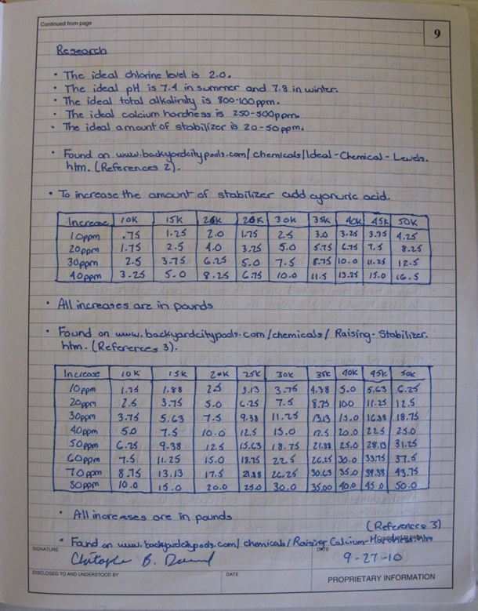
Recommendations
Composition Notebook
All Work done in Pen
All pages have the following:
  Numbered
  Dated
  Signed by the Designer
  Signed by a witness

Slide 5
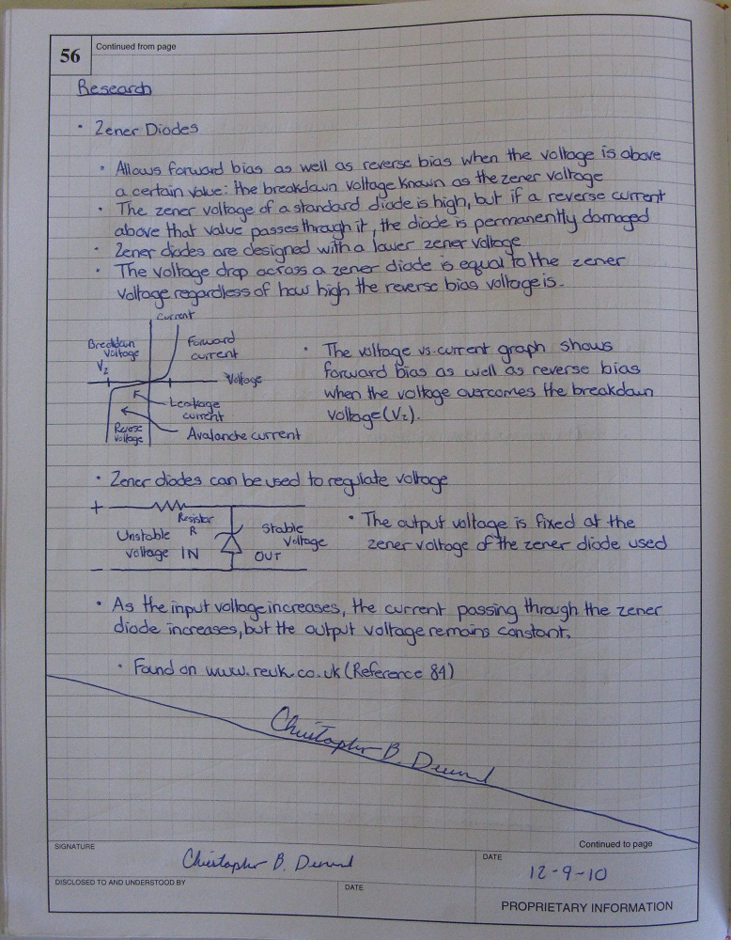
Recommendations
Do NOT leave blank space. Draw a line and sign it.
This keeps others from being able to tamper with your work.

Slide 6
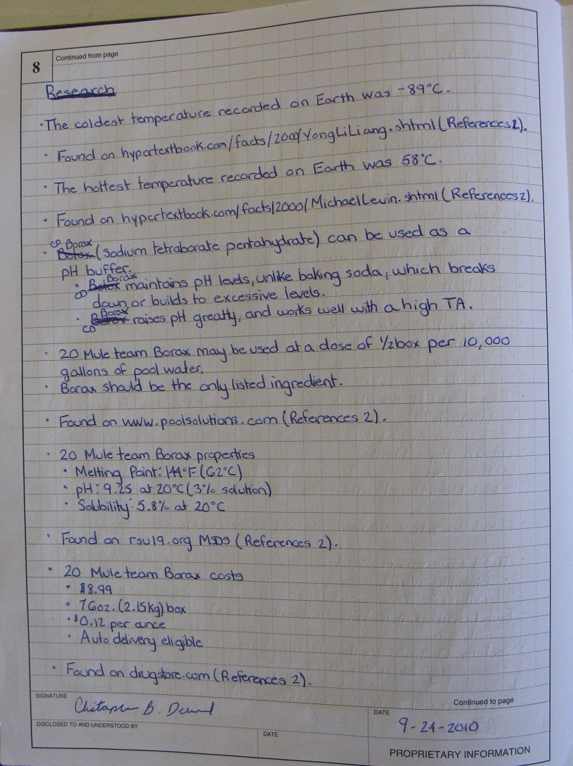
Recommendations
If a mistake is made, cross a line through, make the correction, and initial your cross through

Slide 7
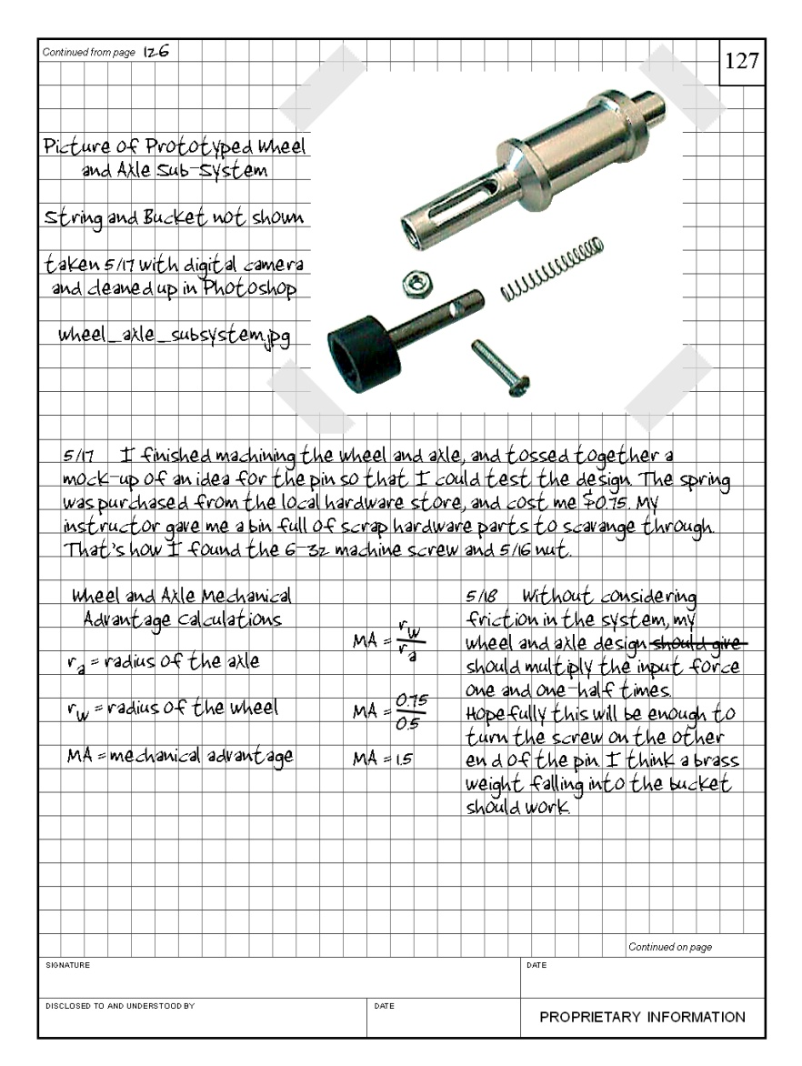
Recommendations
Cut and paste print-outs of digital media into your notebook.
Sign your name across it so that part of your signature on the print out and part of it onto the composition notebook.
This keeps others from tampering with your notebook.
Notes:
Glue is preferred.
Write a description of what you have inserted
No loose papers in the Engineering journal

Slide 8
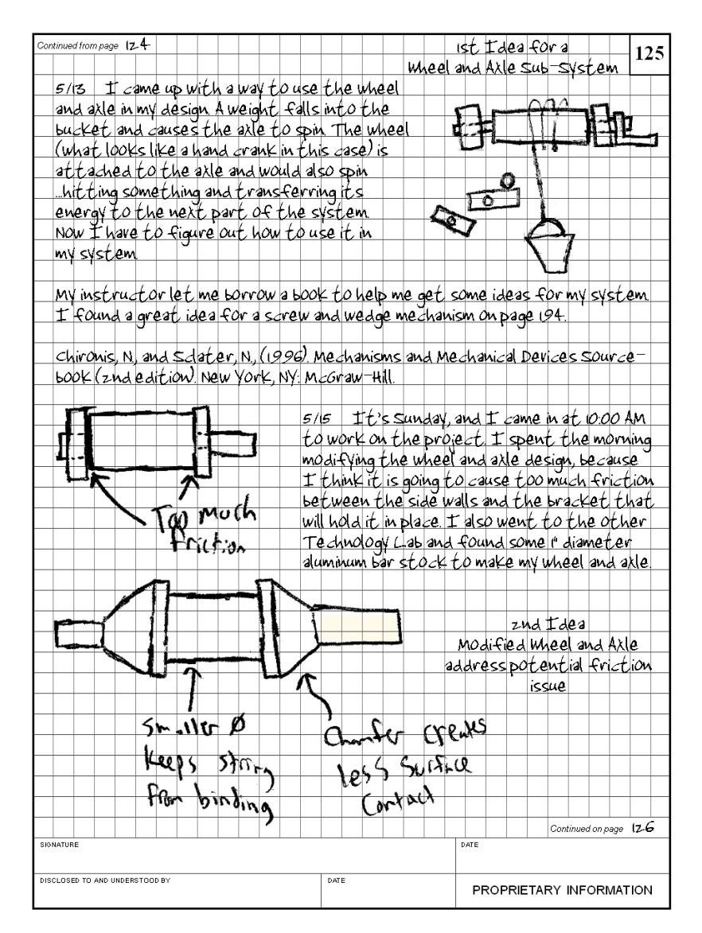
Recommendations
Sketches and Drawings
  Make sure to label all parts of the sketch.
  Describe each sketch in detail so the reader understands the idea.
  Include important dimensions
Notes:
Make sure anyone picking up your notebook for the 1st time can understand your flow of ideas.

Slide 9
Final Thoughts
BE NEAT
BE THOROUGH
BE LEGIBLE
BE ACCURATE
WRITE IN IT EVERY DAY of the PROJECT!

