Slide 1
Design
How would you describe the word “design”?
Did you describe it as a noun or verb; as something created or as a process?
How many types of designers or designs can you list?
Notes:
How many types of designers or designs can you list?
Some examples might include mechanical design, fashion designer, landscape design, graphic design, web design, etc.

Slide 2
What is Design?
The word “design” is often used as a generic term that refers to anything that was made by a conscious human effort.
Design is also a process that is used to systematically solve problems.
Notes:
Talk to students about how they use a sense of design every day. The process for getting ready for school is one example.

Slide 3
Design
To create or execute in an artistic or highly skilled manner
An iterative decision-making process that produces plans by which resources are converted into products or systems that meet human needs and wants or solve problems
A plan or drawing produced to show the look and function or working drawings of something before it is built or made
©iStockphoto.com

Slide 4
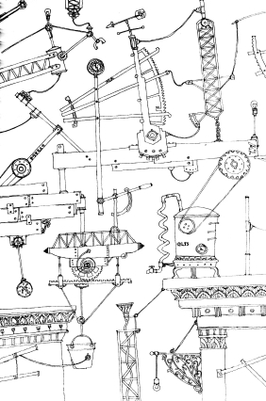
Design by visualization
If the designer is not serving as the builder, then the plans and ideas must be communicated
Often accomplished through drawings
What are some advantages and disadvantages of separating duties of the designer from those of the builder?
iStockphoto.com
Notes:
Types of drawings include sketches, production drawings, presentation drawings, etc.
Drawings should include the design development process in the engineering notebook and finalized drawings.
Advantages and Disadvantages: (examples)
This process allows people to become more specialized and concentrate on design strengths.
Drawings can be manipulated much quicker, easier, and with less cost than physical examples.
The flexibility of creating drawings allows designers to keep pace with technological advancement, to experiment more, and to be more creative.
A design shows how a product looks, but not necessarily how it will function. CAD programs, however, are becoming better at closing that gap.
The disconnect between the designer and the craftsperson may also mean that the designer might create something that cannot be built or that defies physical laws.

Slide 5
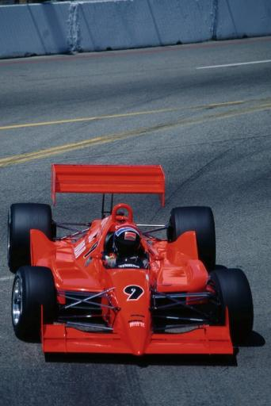
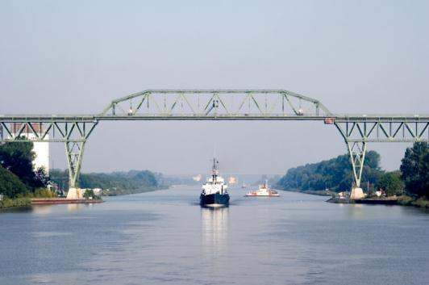
Design by math/science
Craft-designed products generally are time-tested and evolve slowly
Design by drawing increases the speed of change and innovation of new designs
What are advantages of utilizing science and math principles as part of the design?
What are some science and math principles related to the images shown?

Slide 6
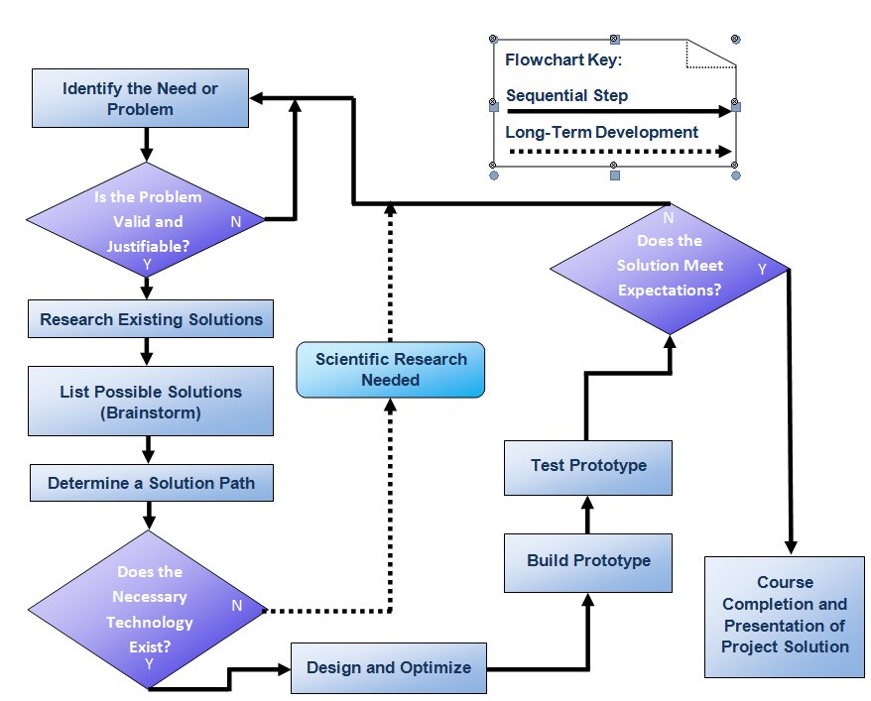
THE DESIGN PROCESS

Slide 7
3 Primary Sections of Design Process
Research and Exploration | Design and Construction | Testing and Documenting
Problem Selection | Design Matrix | Ground Based Testing
Problem Statement | Initial Design Proposal With Sketches | Testing Procedures
Validation and Justification | Refinement of idea with Sketches | Recording Data
Past and Present Solutions | Material selection | Re-design and Refine
Problem Proposal | Mock-Up and Modeling | Final Prototype
 | Prototype Construction | Presentation of Findings

Slide 8
Choosing a Good Topic
Is it a Valid Problem?
Is it a Justifiable Problem?
Does it have potential to make a difference?

Slide 9
Identifying a VALID and JUSTIFIED Problem
Must Concisely define the problem
No Known Solution
Solution can be significantly improved upon
Must be VALID
Credible sources agree it’s a valid problem
Effort is justifiable due to need and cost
Problem Statement
Well written allows you to focus your efforts and provide a measure for success of the design (similar to hypothesis)

Slide 10
Brainstorming
Rapid Process of several different potential solutions
No criticism allowed
Work for Quantity
Piling on of ideas Welcome
Free-For -All

Slide 11
Brainstorming Techniques
SCAMMPERR
S | Substitute something . . .
C | Combine it with something else . . .
A | Adapt something to it . . .
M | Magnify or add to it . . .
M | Modify it . . .
P | Put it to some other use . . .
E | Eliminate something . . .
R | Rearrange it . . .
R | Reverse it . . .
Notes:
Michael Michalko, the author of Cracking Creativity, suggests a more structured approach to brainstorming. In the SCAMMPERR technique, you start with a current solution that somehow addresses the problem that you are investigating. Then try to generate new and different ideas or approaches by using each of the principles listed. For example, if you are trying to design a single-person motor vehicle to be used in a heavily congested urban environment, start with a moped.
Substitute something – perhaps substitute the large front wheel with a small wheel.
Combine it with something else – maybe combine the moped with a shopping cart.

Slide 12
Mind Mapping
Brainstorming Techniques
Major Idea
Major Idea
Main Idea
Major Idea
Major Idea
Major Idea
Notes:
A mind map is a graphical representation that can be used to generate, visualize, and organize ideas to solve a problem. The ideas are arranged in a branching fashion according to relative importance, with the major ideas branching directly from the center main idea. Other ideas that are triggered by or related to the major ideas are then connected to major ideas.
Colors are often used to distinguish between major ideas.
[click] Additional connections can also be added to indicate relationships among different elements.

Slide 13
How to Narrow Down after Brainstorming Topics
Areas of Interest
Large Problems within areas of interest
Manageable problems within areas of interest
Preliminary Research
Validate the Problem
Concise problem statement

Slide 14
What makes a GOOD Problem Statement
Concise
Leaves Room for Multiple Solutions
Does not IMPLY the solution
Solvable in the given time frame and available resources
Answers the following questions
Who has the problem
What exactly is the problem
Where does the problem exist
When has it happened and for how long
How prevalent is the problem (statistically)
IS the problem Valid (who says there is a problem?)

Slide 15
Problem statement Example
Bad Problem Statement
Lots of people go fishing for red fish and do not catch anything.
There aren’t as many red fish as there used to be.
Good Problem Statement
Game fishermen fishing in the lower Laguna Madre of Texas reported between 2002-2007 a decrease of 20% in red drum (i.e., sciaenops ocellatus). This loss can be attributed to premature death due to mouth infections caused when undersized fish are caught and released.
Good Problem statement answers the questions
Who? What? Where? When?
How Many?

Slide 16
Problem Statement Example 2
Car accidents are occurring because the intersection needs to be redesigned.
What are some issues with this problem statement?
Only cars or all vehicles?
Are vehicles hitting vehicles? Other objects? Pedestrians?
What is the current design of the intersection?
Does the intersection really need to be redesigned, or could the solution involve the lights, speed limits, lane configurations, traffic violation enforcement, etc.?
.
Revise the problem statement
Notes:
[Ask students to write a good problem statement for this problem.]
[click] Answers to these questions may help you write a good problem statement.

Slide 17
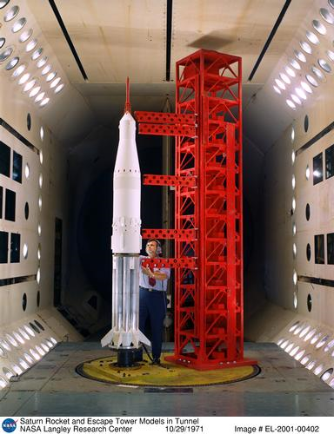
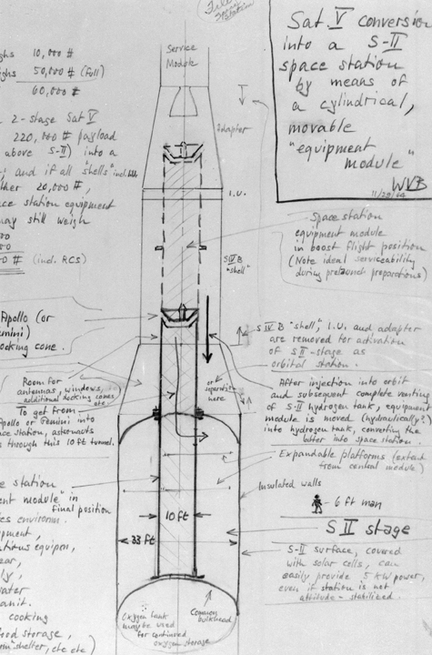
What is a Design Process?
A design process is a systematic problem-solving strategy, with criteria and constraints, used to develop many possible solutions to solve or satisfy human needs or wants and to narrow down the possible solutions to one final choice.
– ITEA Standards for Technological Literacy
Images courtesy of NASA
Notes:
The first image is a von Braun sketch from 1964.
The second is an engineer in 1971 working with a Saturn V model.

Slide 18
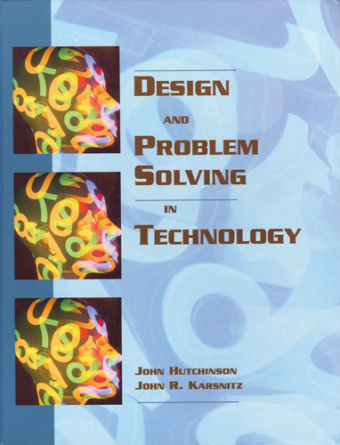
Design Process Example
Identify problems and opportunities
Frame a design brief
Investigate and research
Generate alternative solutions
Choose a solution
Developmental work
Model and prototype
Test and evaluate
Redesign and improve
Design and Problem Solving in Technology
Notes:
Several different design processes are used successfully in both industry and academia.

Slide 19
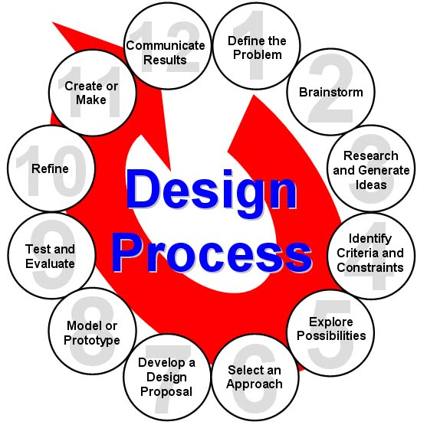
Design Process Example
Define the Problem
Brainstorm
Research and Generate Ideas
Identify Criteria and Specify Constraints
Explore Possibilities
Select an Approach
Develop a Design Proposal
Make a Model or Prototype
Test and Evaluate the Design
Refine the Design
Create or Make Solution
Communicate Processes and Results
– ITEA Standards for Technological Literacy
Notes:
Many different design processes guide professionals in developing solutions to problems. The example that you see here is the design process implemented in PLTW courses.

Slide 20
1. Define the Problem
Receive a problem to solve from the client
Gather information
Gather inspiration through media exposure of a current problem and take action

Slide 21
2. Brainstorm
Present ideas in an open forum
Generate and record ideas
Keep the mind alert through rapidly paced sessions
Develop preliminary ideas

Slide 22
3. Research and Generate Ideas
Conduct interviews with those affected by the problem
Research solutions that may already exist; identify shortcomings and reasons why they aren’t appropriate to a given situation
Compile ideas and report findings to the team

Slide 23
4. Identify Criteria and Constraints
Identify what the solution should do and the degree to which the solution will be pursued
Identify constraints (i.e., budget and time)
Draft the Design Brief

Slide 24
5. Explore Possibilities
Consider further development of brainstorming ideas with constraints and tradeoffs
Explore alternative ideas based on further knowledge and technologies

Slide 25
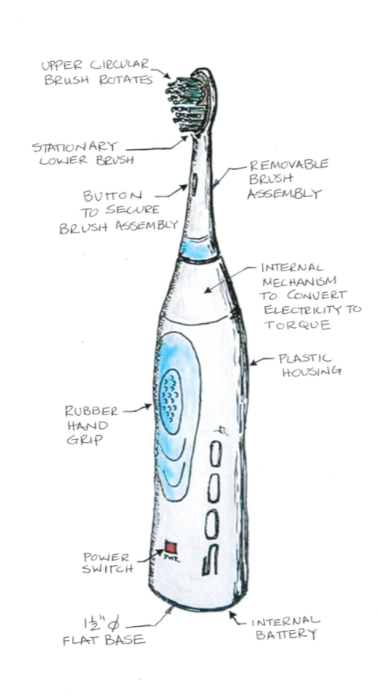
Product Concept Sketches
STAPLER DESIGN
Annotated Sketches
TOOTHBRUSH DESIGN
Notes:
Product concept sketches should include a neat 2D or 3D sketch with annotation to identify the important parts of the design and general dimensions. The level of detail of the sketch and annotations necessary to describe the product varies depending on the product and its complexity.

Slide 26
6. Select an Approach
Review brainstormed information and answer any lingering questions
Narrow ideas down through a voting process or by use of a decision matrix
Decide on final idea, usually through group consensus

Slide 27
7. Develop a Design Proposal
Explore the idea in greater detail with annotated sketches
Make critical decisions such as material types and manufacturing methods
Generate through computer models detailed sketches to further refine the idea
Produce working drawings so the idea can be built

Slide 28
8. Model or Prototype
Make models to help communicate the idea; study aspects such as shape, form, fit, or texture
Construct a prototype from the working drawings in order to test solution

Slide 29
9. Test and Evaluate
Design experiments and test the prototype in controlled and working environments
Gather performance data; analyze and check results against established criteria
Conduct a formal critique to flesh out areas of concern, identify shortcomings, and establish any need for redesign work

Slide 30
10. Refine
Make design changes; modify or rebuild the prototype
Make refinements until accuracy and repeatability of the prototype’s performance results are consistent
Update documentation to reflect changes
Receive user’s critique to provide outside perspective to help determine whether established criteria have been met

Slide 31
11. Create or Make
Determine custom/mass production
Consider packaging

Slide 32
12. Communicate Results
Communicate the designer’s final solution through media such as PowerPoint, poster session, technical report
Market the product
Distribute

