Slide 1
Brainstorming Solutions
Brainstorming
Brainstorming Techniques
Concept Generation Dysfunctions
If you Get Stuck . . .

Slide 2
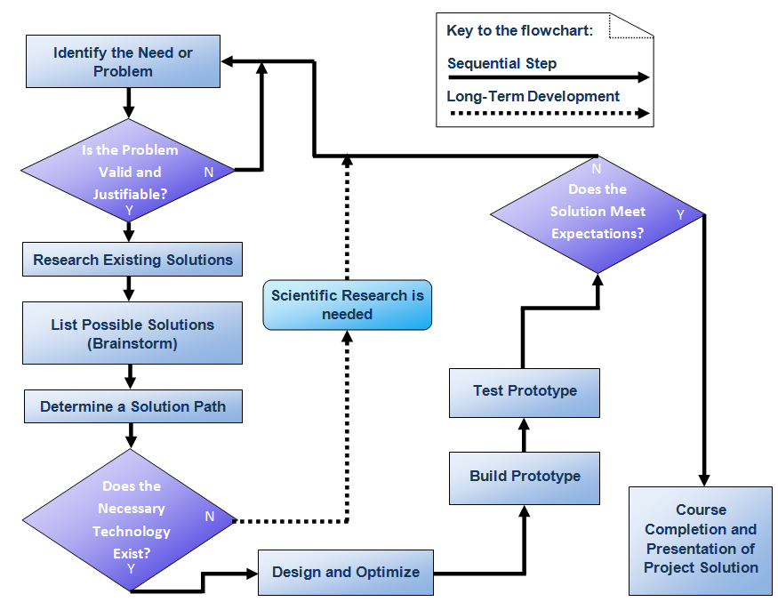
Brainstorming Solutions
Notes:
[click] Once a problem has been researched, validated, and justified, a dedicated search for potential solutions may begin in earnest.

Slide 3
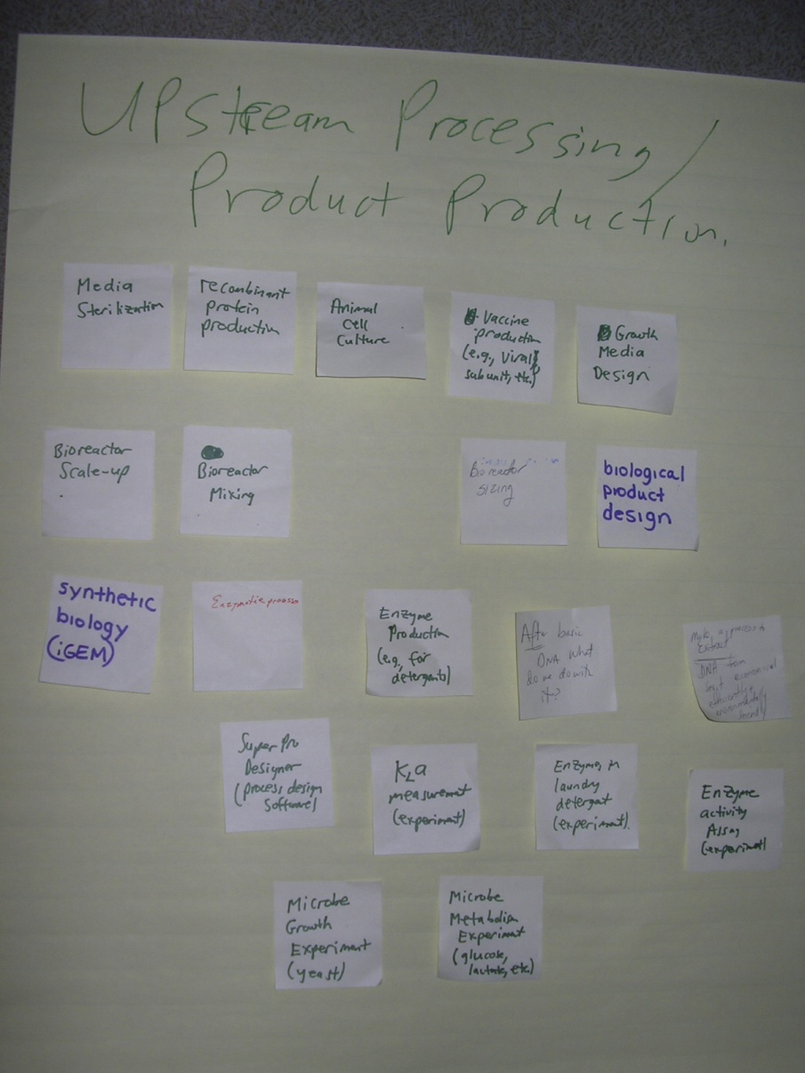
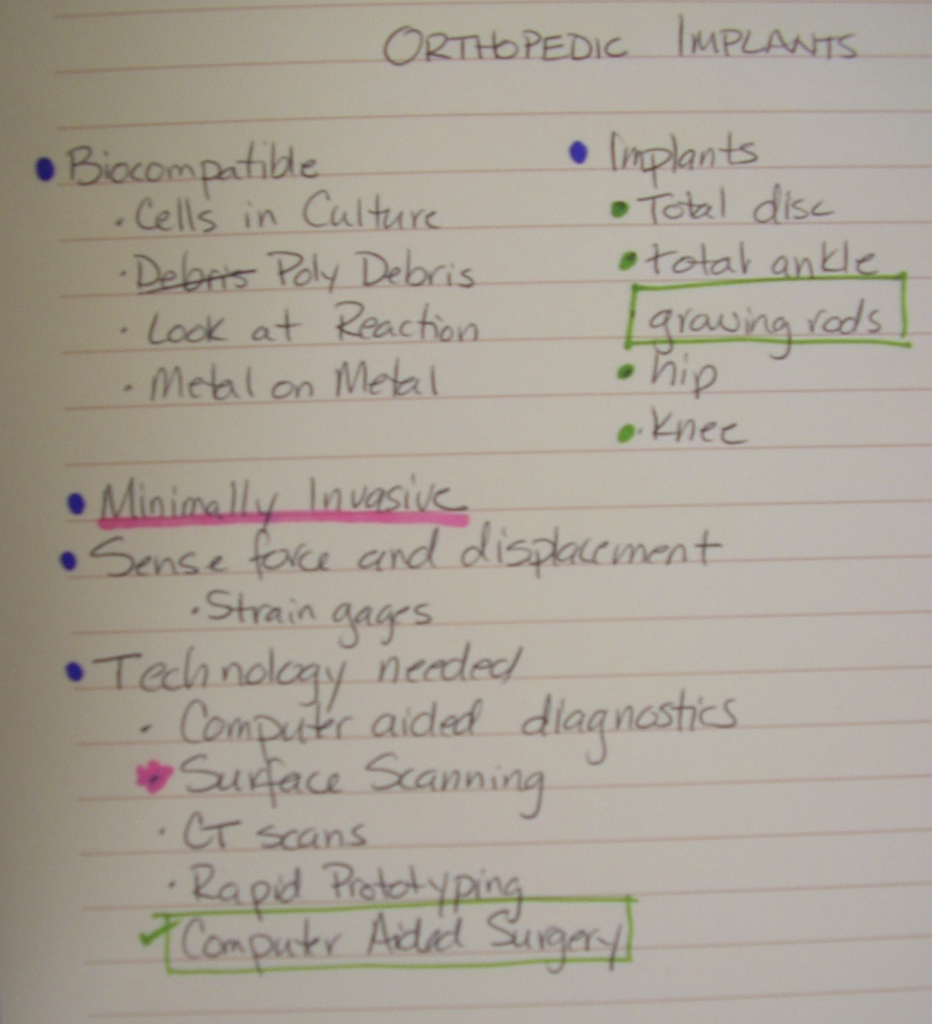
Free Form Brainstreaming
Brainstorming Techniques
Post-It Notes
Free writing
“Blurting out”

Slide 4
Brainstorming Techniques
SCAMMPERR
S | Substitute something . . .
C | Combine it with something else . . .
A | Adapt something to it . . .
M | Magnify or add to it . . .
M | Modify it . . .
P | Put it to some other use . . .
E | Eliminate something . . .
R | Rearrange it . . .
R | Reverse it . . .
Notes:
Michael Michalko, the author of Cracking Creativity, suggests a more structured approach to brainstorming. In the SCAMMPERR technique, you start with a current solution that somehow addresses the problem that you are investigating. Then try to generate new and different ideas or approaches by using each of the principles listed. For example, if you are trying to design a single-person motor vehicle to be used in a heavily congested urban environment, start with a moped.
Substitute something – perhaps substitute the large front wheel with a small wheel.
Combine it with something else – maybe combine the moped with a shopping cart.

Slide 5
Mind Mapping
Brainstorming Techniques
Major Idea
Major Idea
Main Idea
Major Idea
Major Idea
Major Idea
Notes:
A mind map is a graphical representation that can be used to generate, visualize, and organize ideas to solve a problem. The ideas are arranged in a branching fashion according to relative importance, with the major ideas branching directly from the center main idea. Other ideas that are triggered by or related to the major ideas are then connected to major ideas.
Colors are often used to distinguish between major ideas.
[click] Additional connections can also be added to indicate relationships among different elements.

Slide 6
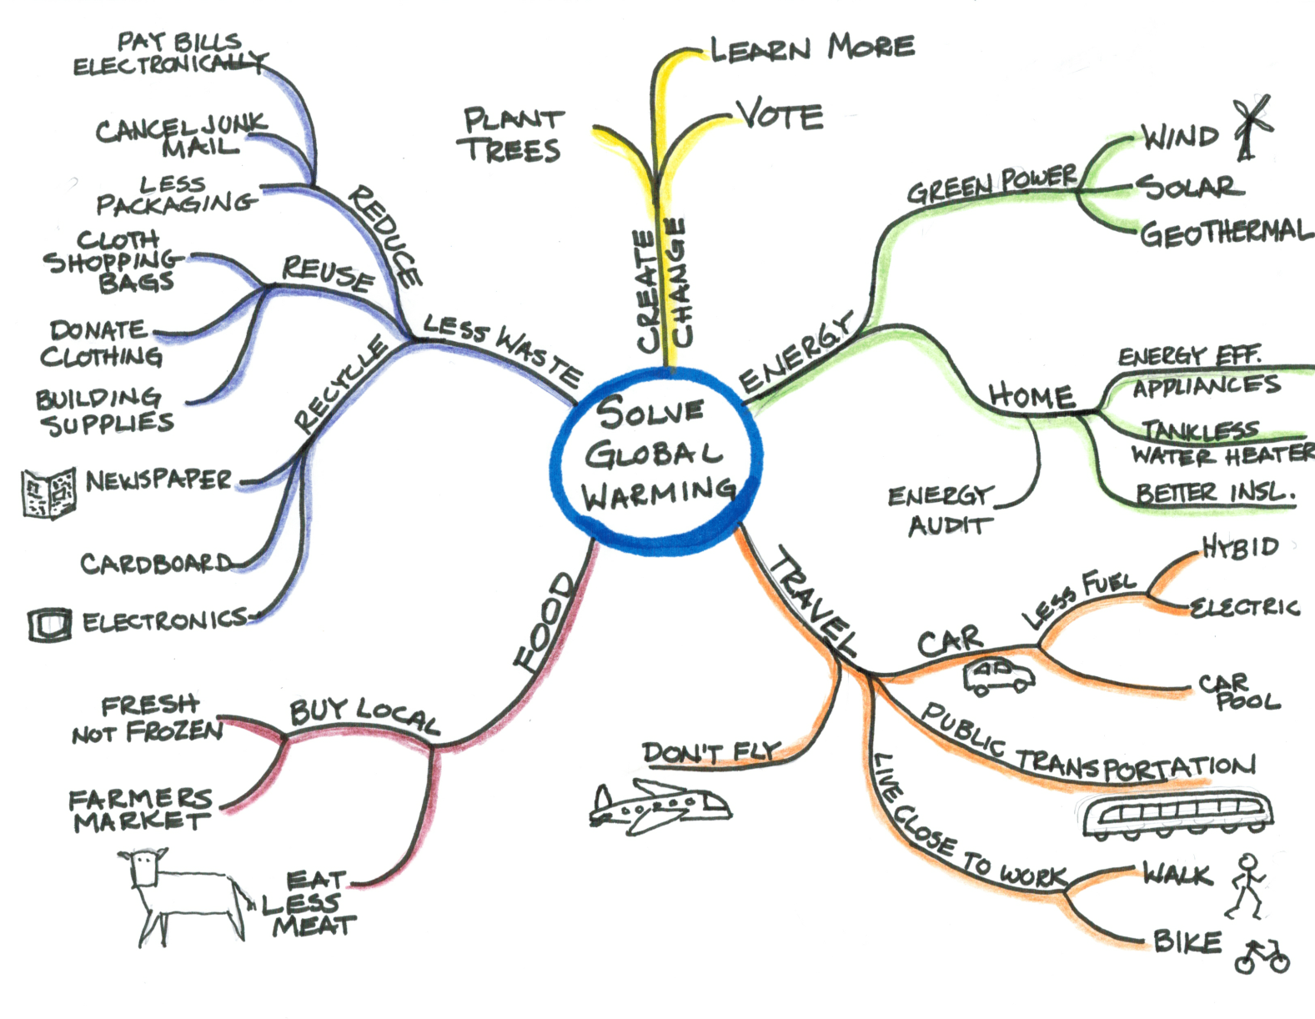
Brainstorming Techniques
Mind Mapping
Notes:
This mind map illustrates ways to help solve global warming.

Slide 7
Brainstorming Documentation
All ideas should be captured
Have a note taker
Take photographs
Compile ideas after the session

Slide 8
Concept Generation Dysfunctions
Utilizing a poor design brief
Assuming there is only ONE right answer
Getting hooked on the FIRST solution
Considering the ideas from only one or two team members

Slide 9
Concept Generation Dysfunctions
Feeling too anxious to finish
Becoming frustrated by the lack of success
Getting hooked on a solution that almost works

Slide 10
If You Get Stuck . . .
Combine promising partial solutions
Try a different brainstorming technique
Try both individual and group brainstorming
Do some more research
Consider concepts used by other designs
Consider concepts employed in unrelated products

Slide 11
Brainstorming Solutions
Brainstorming
Brainstorming Techniques
Concept Generation Dysfunctions
If you Get Stuck . . .

Slide 12
Image Sources
Microsoft, Inc. (2008). Clip art. Retrieved from http://office.microsoft.com/en-us/clipart/default.aspx

